Slide 1
VECTOR AUTO REGRESSION
BY:
KARTHIK GH
E22020

Slide 2
What is an vector auto regression
Vector Autoregression (VAR) is a multivariate forecasting algorithm that is used when two or more time series influence each other
That means, the basic requirements in order to use VAR are:
1. You need at least two time series (variables).
2.The time series should influence each other.
So why is it called ‘Autoregressive’?
It is considered as an Autoregressive model because, each variable (Time Series) is modeled as a function of the past values, that is the predictors are nothing but the lags (time delayed value) of the series.

Slide 3
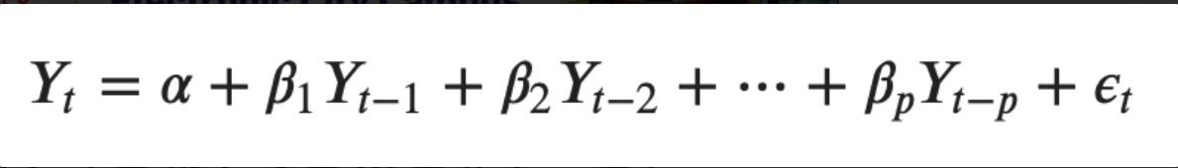
VAR Model Formula
A typical AR(p) model equation looks something like this
where α is the intercept, a constant and β1, β2 till βp are the coefficients of the lags of Y till order p
Order ‘p’ means, up to p-lags of Y is used and they are the predictors in the equation. The ε_{t} is the error, which is considered as white noise.

Slide 4
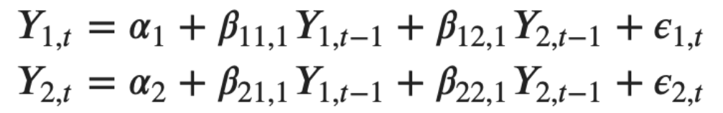
how does a VAR model’s formula look like?
we have two variables (Time series) Y1 and Y2, and we need to forecast the values of these variables at time (t).
To calculate Y1(t), VAR will use the past values of both Y1 as well as Y2. Likewise, to compute Y2(t), the past values of both Y1 and Y2 be used.
For example, the system of equations for a VAR(1) model with two time series (variables `Y1` and `Y2`) is as follows

Slide 5
Building a VAR model in Python
Importing the libraries
Importing the dataset
Test for stationarity
Transform the series to make it stationary, if needed
Test for causation amongst the time series
Find optimal order (p)
Analyze the time series characteristics
Prepare training and test datasets
Train the model
Evaluate the model using test set
Forecast to future

Slide 6
This dataset has the following 8 quarterly time series:
1.rgnp : Real GNP.
2.pgnp : Potential real GNP.
3.ulc : Unit labor cost.
4.gdfco : Fixed weight deflator for personal consumption expenditure excluding food and energy.
5.gdf : Fixed weight GNP deflator.
6.gdfim : Fixed weight import deflator.
7.gdfcf : Fixed weight deflator for food in personal consumption expenditure.
8.gdfce : Fixed weight deflator for energy in personal consumption expenditure.

Slide 7
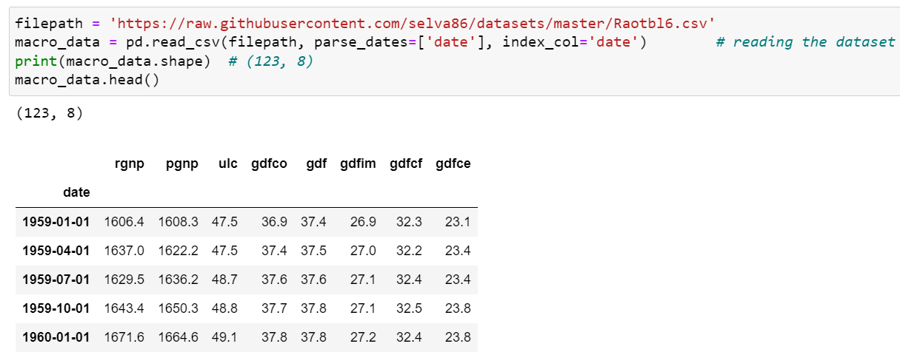
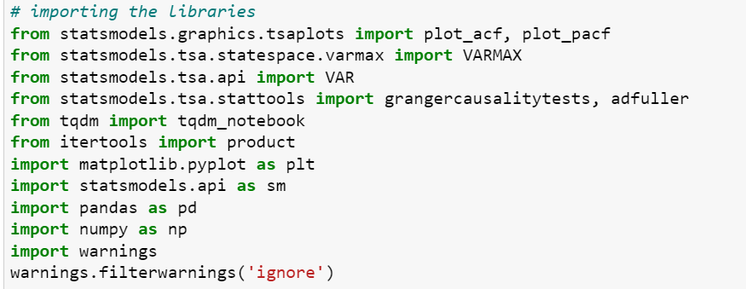
Steps for building var model
Importing libraries
Importing datasets

Slide 8
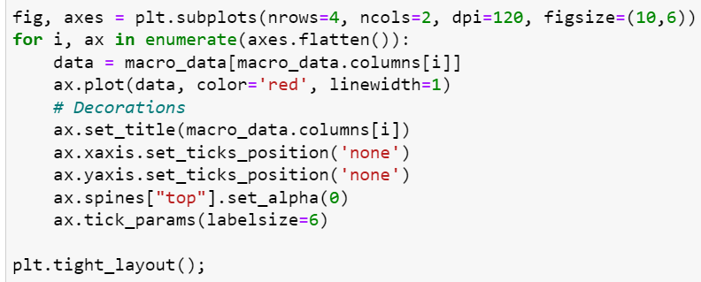
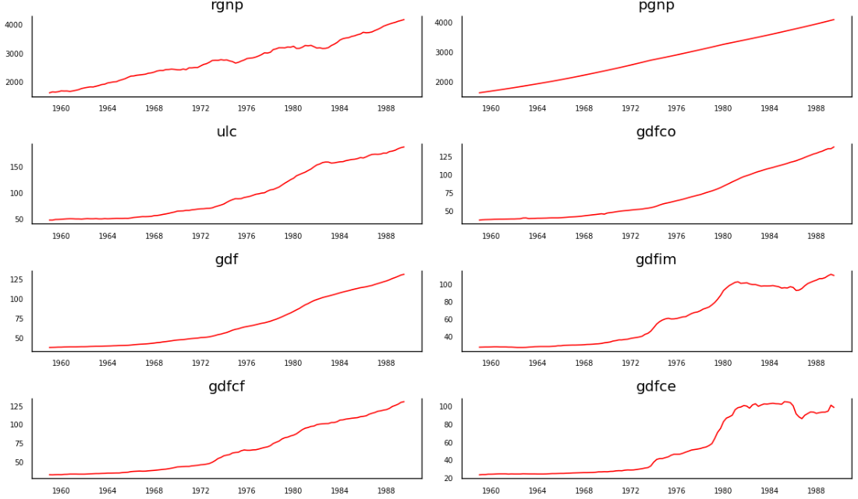
Visualize the Time Series
code
Time series plot

Slide 9
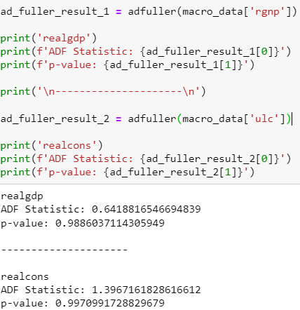
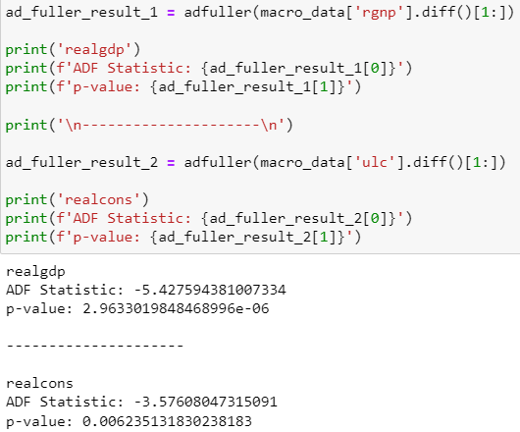
Checking for Stationarity and Make the Time Series Stationary
Test used to check the time series is stationary are;
Augmented Dickey-Fuller Test (ADF Test)
KPSS test
Philip-Perron test
We are using ADA test
First check for stationarity and if there is no stationarity then transform it to stationarity

Slide 10
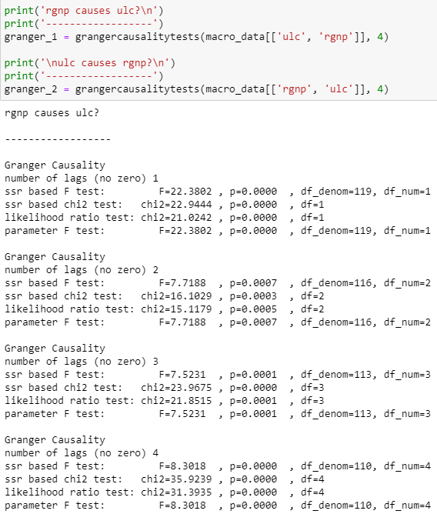
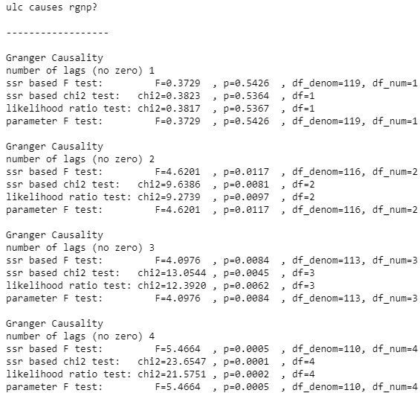
Testing Causation using Granger’s Causality Test
when we are doing vector autoregression it is important to know that the two time series we are working with are they corelated or any correlation b/w them.
Test used to check is ;
Granger’s Causality Test
the past values of time series (X) do not cause the other series (Y). So, if the p-value obtained from the test is lesser than the significance level of 0.05, then, you can safely reject the null hypothesis.

Slide 11

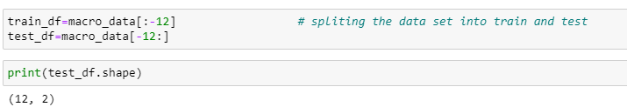
Split the Series into Training and Testing Data
Extracting the data on what we are working with
Splitting the series into train and test

Slide 12
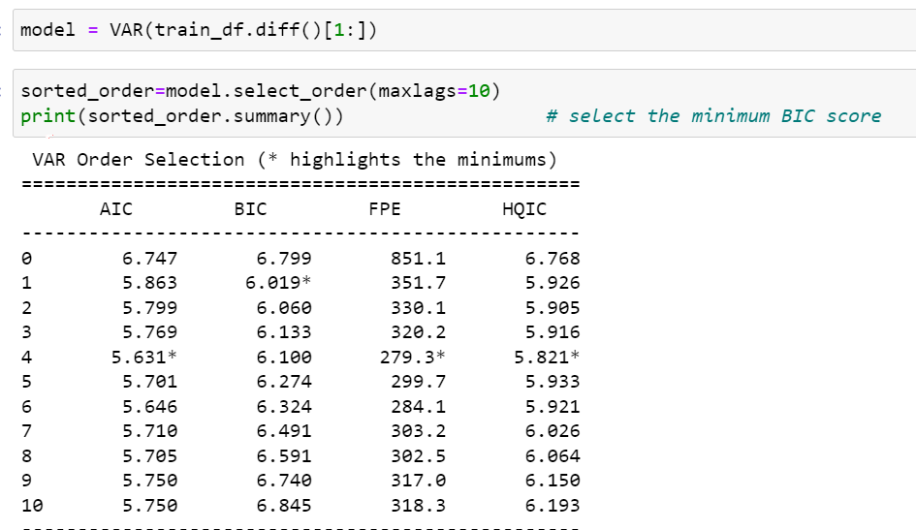
Selecting the Order of VAR model

Slide 13
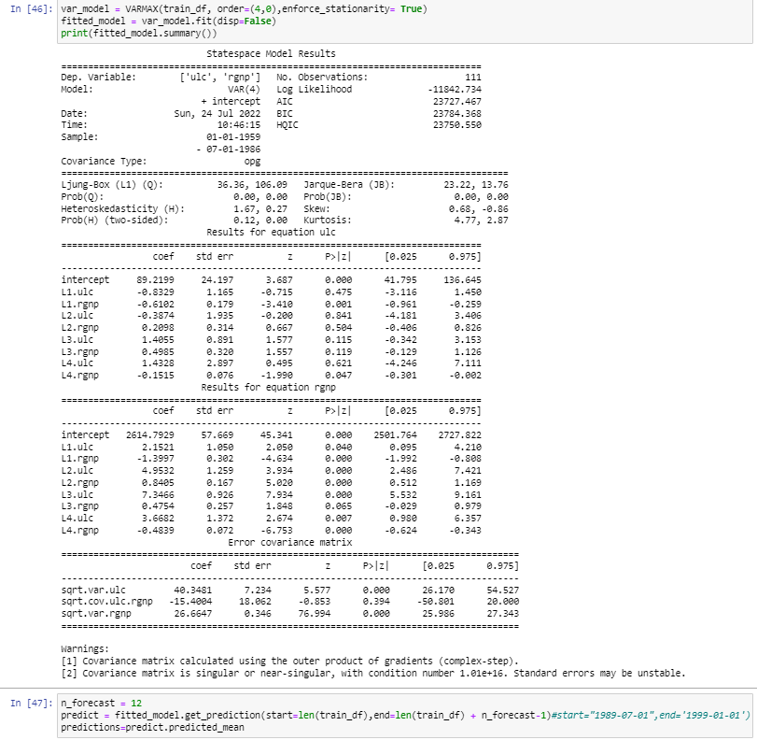
Fitting the model and forecasting

Slide 14
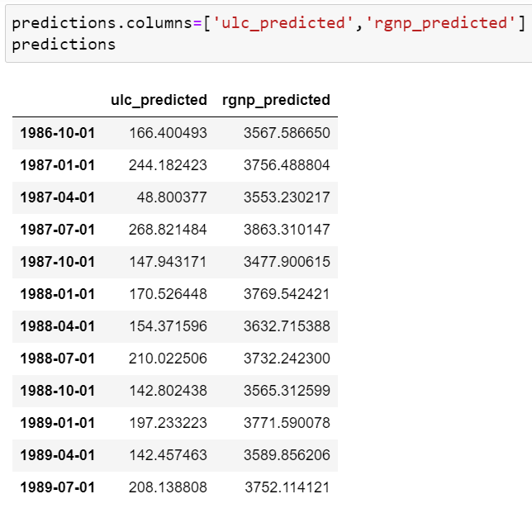
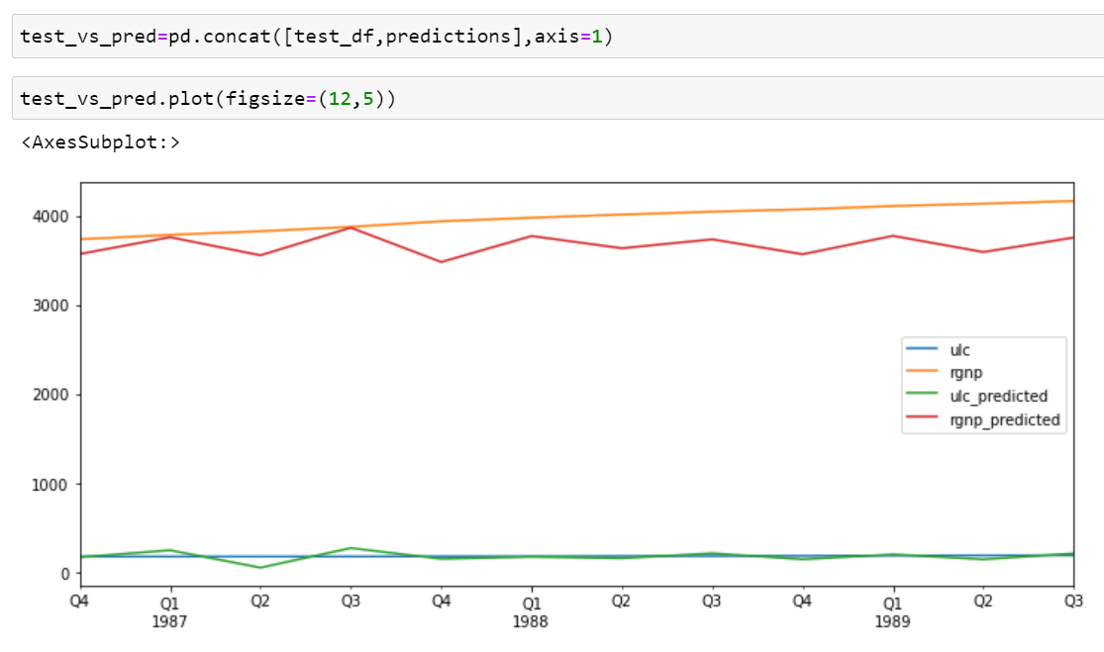
Forecast to future

Slide 15
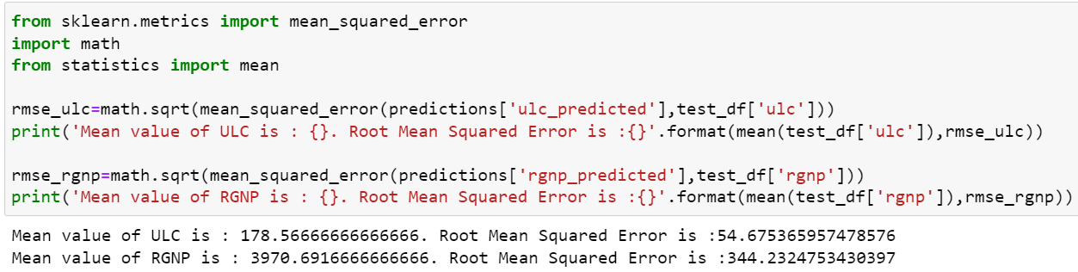
Evaluate the model using test set

Slide 16
THANK YOU

